Slide 1

Paper ID: 1745 Paper Title: Machine learning-based automated medical diagnosis for healthcare
Presented by:
Harsh Khatter, Ankit Yadav, Ayush Srivastava
Full Affiliation:
Department of Computer Science,
KIET Group of Institutions, Delhi-NCR, Ghaziabad, Uttar Pradesh, India
Presentation Date:
03 March 2023

Slide 2
Table of Content
Introduction
Literature
Proposed Solution
Methodology
Model Module
Social Impact Analysis
Conclusion
References

Slide 3
Introduction
The health problem is the gap between acceptable or desirable and present health status.
This project is based on real-time implementation as well as more informative and realistic.
It can be highly used in Medical Diagnosis and understanding the different feasibilities of the model.
In such unprecedented times, with a fragile healthcare infrastructure, medical facilities for people are scarce, and even fewer for people with special needs. The healthcare sector got so preoccupied with Covid-19 cases that people with other ailments didn't even get a chance to avail medical assistance. So, We are here to present a model to mitigate the scarcity of facilities and the lack of medical management.

Slide 4
Literature
In the list of the top 10 causes of death over the past 15 years, the world's worst disease, which claimed 15 million lives in 2015, holds the top spot [8][9][10].
People, in all areas, don’t have access to medical aid. The healthcare industry is no so strong to deal with all situations. Covid is one of the example [20].
Tamilselvan. P [1] monitors based on blood pressure and ECG readings are available. Reactions are kept the signals that these sensors transmit to the Using a signal conditioner and amplifier, Raspberry Pi is used.
Vivek Datla, Sadid A. Hasan [2] outline the Knowledge Graph (KG)-system for based clinical diagnostic inference.
Fabio Santos, Filipe Silva and Petia Georgieva [4] focused on the skin lesion diagnosis techniques integrated inside eHealth apps that help individuals and medical professionals and are clearly needed as the prevalence of skin cancer grows.
Berina Ali [5] provides an overview of machine learning methods for categorizing CVD and diabetes using artificial neural networks (ANNs) and Bayesian networks (BNs).

Slide 5
Proposed Solution
Integration of clinical decision support with computer-based patient records could
Reduce medical errors.
Automated Diseases Prediction System.
Doctor Recommendation System
Online Consultation/Appointment with Labs/Doctors.
Path-labs Booking
Decentralized Patient Records
Integrate doctors and patients via an interacting and user-friendly interface so that Patients can easily utilize it in emergency situations.

Slide 6
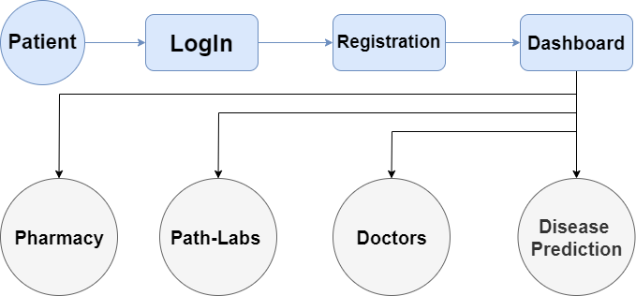
Methodology
Prediction involves some variables or fields in the dataset to predict unknown or future values of other variables of interest.
Description focuses on finding patterns describing the data that can be interpreted by humans.
Presentation plays an important role to easily understandable to humans i.e., augmented reality.

Slide 7
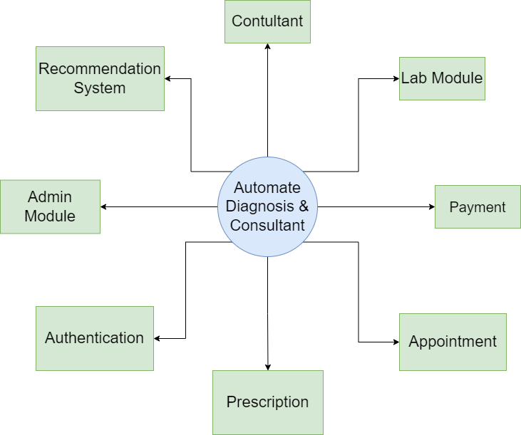
Modules of Proposed Model
There are four Module in our model.
Doctor module
Patient Module
Lab Module
Admin Module

Slide 8
Social Impact Analysis
Integration of clinical decision support with computer-based patient records could reduce medical errors, enhance patient safety.
It deceases unwanted practice variation and improve practice outcome which can help significantly improve the quality of clinical decisions.
Reduce disease identification time and start treatment expeditiously.
Reduce the cost of medical tests & by providing initial diagnostics in time that reduce huge amount of burden on patient’s family.

Slide 9
Conclusion
Integrate physicians and patients with an interactive and user-friendly interface so that patients may use it in an emergency. This model's three key purposes are prediction, description, and presentation.
The patient's biometric data, which is captured, published online, and transferred to cellular devices, may be made available to scientists and researchers in medical disciplines in order to evaluate its value and reveal patterns, as well as for other research objectives.
Using the data mining modeling technique, the integration of clinical decision support with computer-based patient records could decrease medical errors, increase patient safety, stop unwelcome practice variance, and improve practice outcomes.
Connecting patients and doctors through a user-friendly interface will make it easier for patients to use in emergency situations.

Slide 10
REFERENCES
V. S. Pendyala and S. Figueira, "Automated Medical Diagnosis from Clinical Data," 2017 IEEE Third International Conference on Big Data Computing Service and Applications (BigDataService), 2017, pp. 185-190, doi: 10.1109/BigDataService.2017.14.
F. Santos, F. Silva and P. Georgieva, "Automated Diagnosis of Skin Lesions," 2020 IEEE 10th International Conference on Intelligent Systems (IS), 2020, pp. 545-550, doi: 10.1109/IS48319.2020.9200090.
V. Datla et al., "Automated clinical diagnosis: The role of content in various sections of a clinical document," 2017 IEEE International Conference on Bioinformatics and Biomedicine (BIBM), 2017, pp. 1004-1011, doi: 10.1109/BIBM.2017.8217794.
F. Ertam and G. Aydın, "Data classification with deep learning using Tensorflow," 2017 International Conference on Computer Science and Engineering (UBMK), 2017, pp. 755-758, doi: 10.1109/UBMK.2017.8093521.
H. Božiković and M. Štula, "Web design — Past, present and future," 2018 41st International Convention on Information and Communication Technology, Electronics and Microelectronics (MIPRO), 2018, pp. 1476-1481, doi: 10.23919/MIPRO.2018.8400266.
D. S. Blyth, "Web page design for HTML (and friends)," IPCC 96: Communication on the Fast Track. IPCC 96 Proceedings, 1996, pp. 89-103, doi: 10.1109/IPCC.1996.552585
N. Sandhya and K.R. Charanjeet, "A review on Machine Learning Techniques", International Journal on Recent and Innovation Trends in Computing and Communication, pp. 395-399, 2016, ISSN 2321-8169.
D. Fagella, 7 Applications of Machine Learning in Pharma and Medicine, 2017, [online] Available: https://goo.gl/IS1R5k.
P. Ongsulee, "Artificial intelligence, machine learning and deep learning," 2017 15th International Conference on ICT and Knowledge Engineering (ICT&KE), 2017, pp. 1-6, doi: 10.1109/ICTKE.2017.8259629.
R. Chellappa, S. Theodoridis and A. van Schaik, "Advances in Machine Learning and Deep Neural Networks," in Proceedings of the IEEE, vol. 109, no. 5, pp. 607-611, May 2021, doi: 10.1109/JPROC.2021.3072172.
B. Alić, L. Gurbeta and A. Badnjević, "Machine learning techniques for classification of diabetes and cardiovascular diseases," 2017 6th Mediterranean Conference on Embedded Computing (MECO), 2017, pp. 1-4, doi: 10.1109/MECO.2017.7977152.

Slide 11
Paper ID: 1745 Paper Title: Machine learning-based automated medical diagnosis for healthcare
Thank You
Presented by:
Harsh Khatter, Ankit Yadav, Ayush Srivastava
Department of Computer Science, KIET Group of Institutions, Delhi-NCR, Ghaziabad, Uttar Pradesh, India

